Slide 1



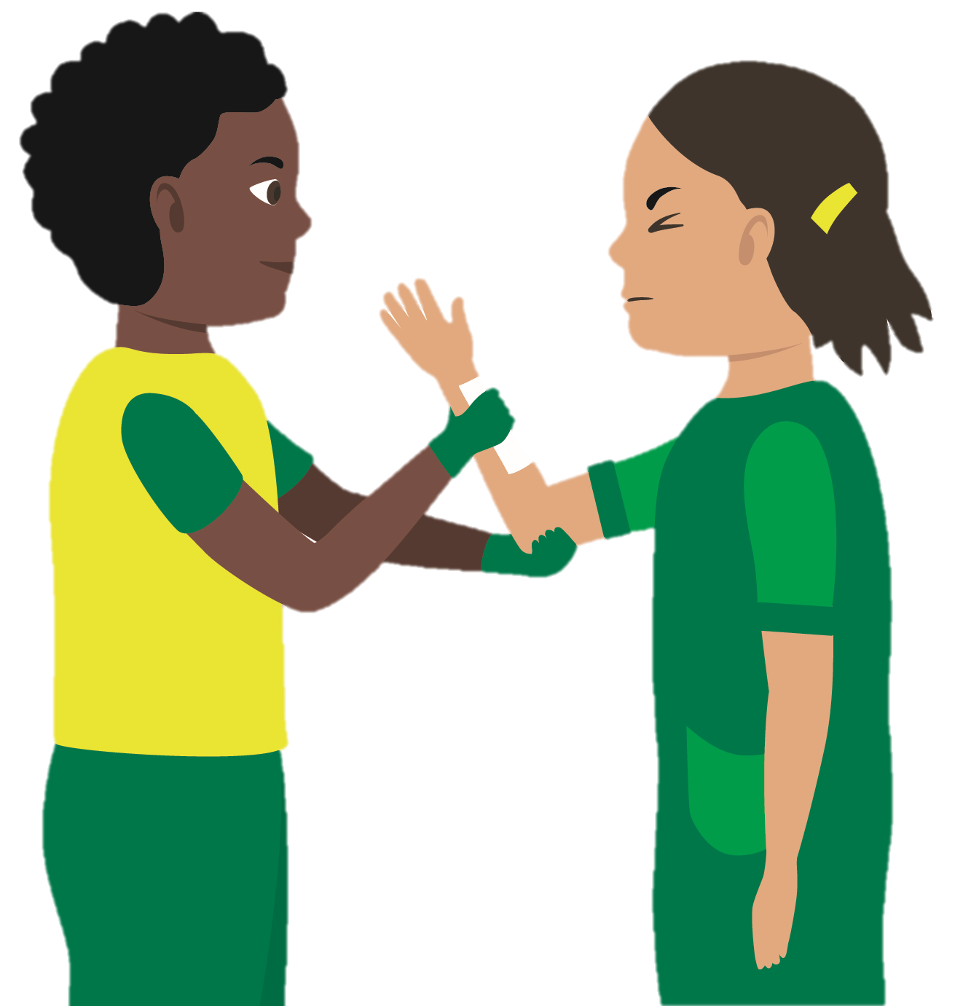
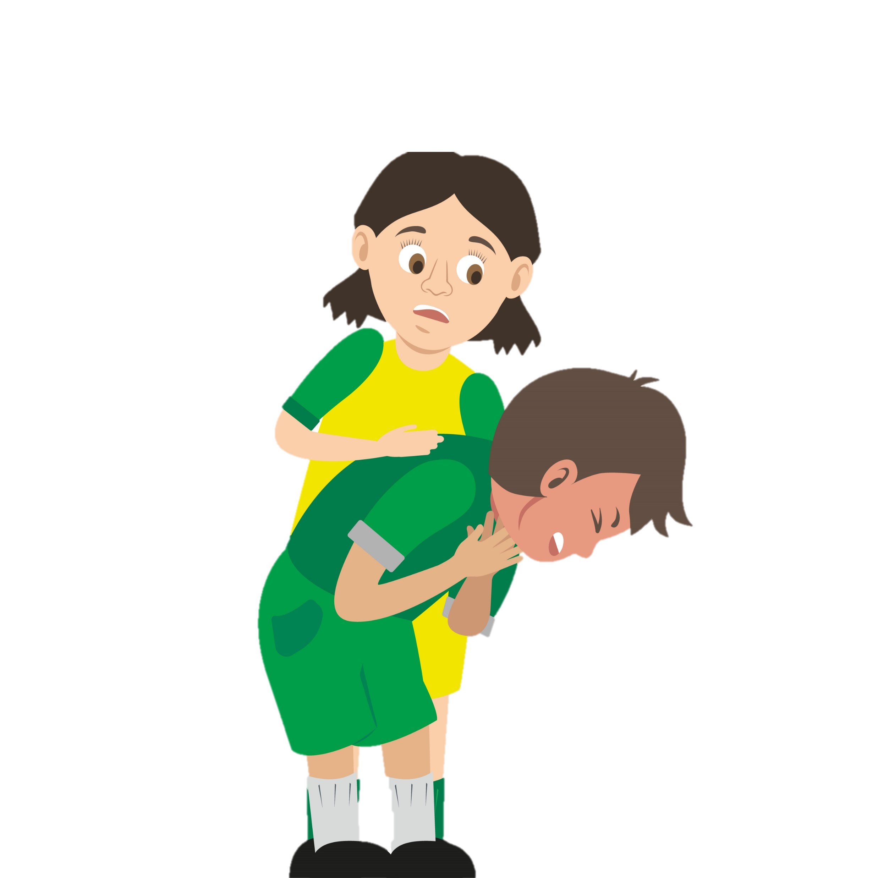





KS4 Statutory and Recommended First Aid Pathway
The Department for Education recommends that pupils at KS4 should know:
How and when to deliver CPR and understand the concept and use of Automated External Defibrillation (AED)
In addition we suggest you also understand the concepts of common first aid emergencies and consider a recap of first aid skills gained at KS2 and KS3.
Follow the map of health agenda recommendations to provide your pupils with a sound knowledge of first aid.
“Pupils can support their own and others’ health and wellbeing, including basic first aid.”
(Dept of Ed, Feb 2019)
Recommended for every KS4 pupil
Basic life support (CPR and AED)
KS4 – Year 10
Chest Pain
KS4 – Year 10
Bleeding and Shock
KS4 – Year 11
Choking
KS4 – Year 11
Bone, Muscle and Joint Injuries
Well done…
if you have completed all these modules you are a KS4 first aider
“Children and young people are growing up in an increasingly complex world….they need to know how to be safe and healthy.”
(Secretary of State, Dept of Ed, Health Ed guidance Feb 2019)

