Slide 1



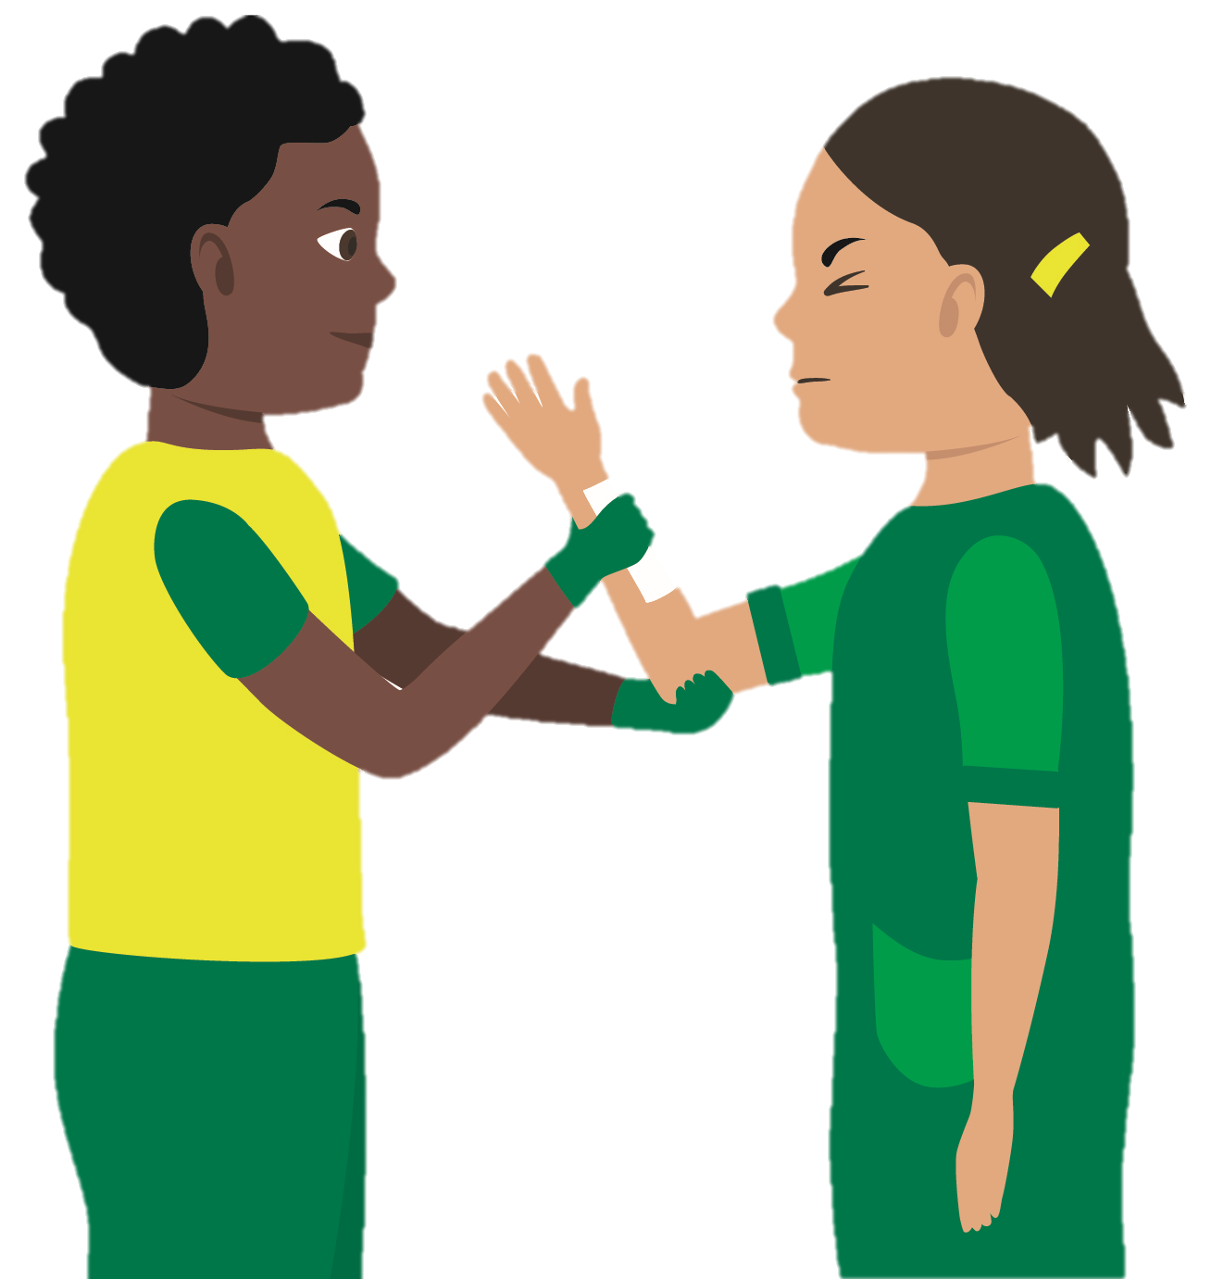
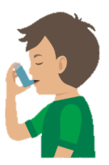


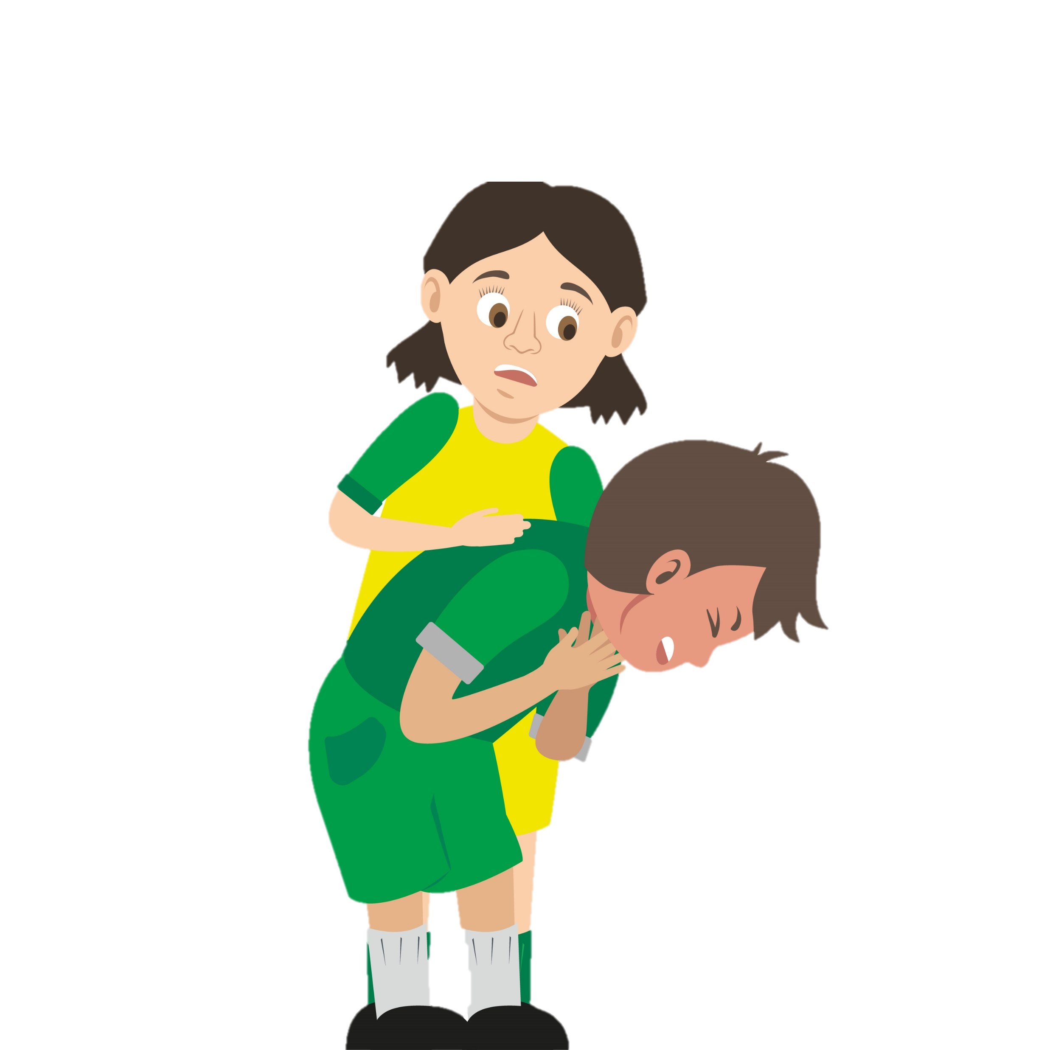



KS3 Statutory and Recommended First Aid Pathway
The Department for Education recommends that pupils at KS3 should know:
How and when to deliver CPR and understand the concept and use of Automated External Defibrillation (AED)
In addition we suggest you also understand the concepts of common first aid emergencies and consider a recap of first aid skills gained at KS2.
Follow the map of health agenda recommendations to provide your pupils with a sound knowledge of first aid.
Recommended for every KS3 pupil
Basic life support (CPR and AED)
“Pupils can support their own and others’ health and wellbeing, including basic first aid.”
(Dept of Ed, Feb 2019)
KS3 – Year 7
Bleeding
KS3 – Year 8
Asthma & Allergies
This way
to KS4 First Aid
Well done…
if you have completed all these modules you are a KS3 first aider
KS3 – Year 9
Choking & Head Injuries
“Children and young people are growing up in an increasingly complex world….they need to know how to be safe and healthy.”
(Secretary of State, Dept of Ed, Health Ed guidance Feb 2019)

