Slide 1


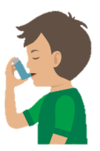


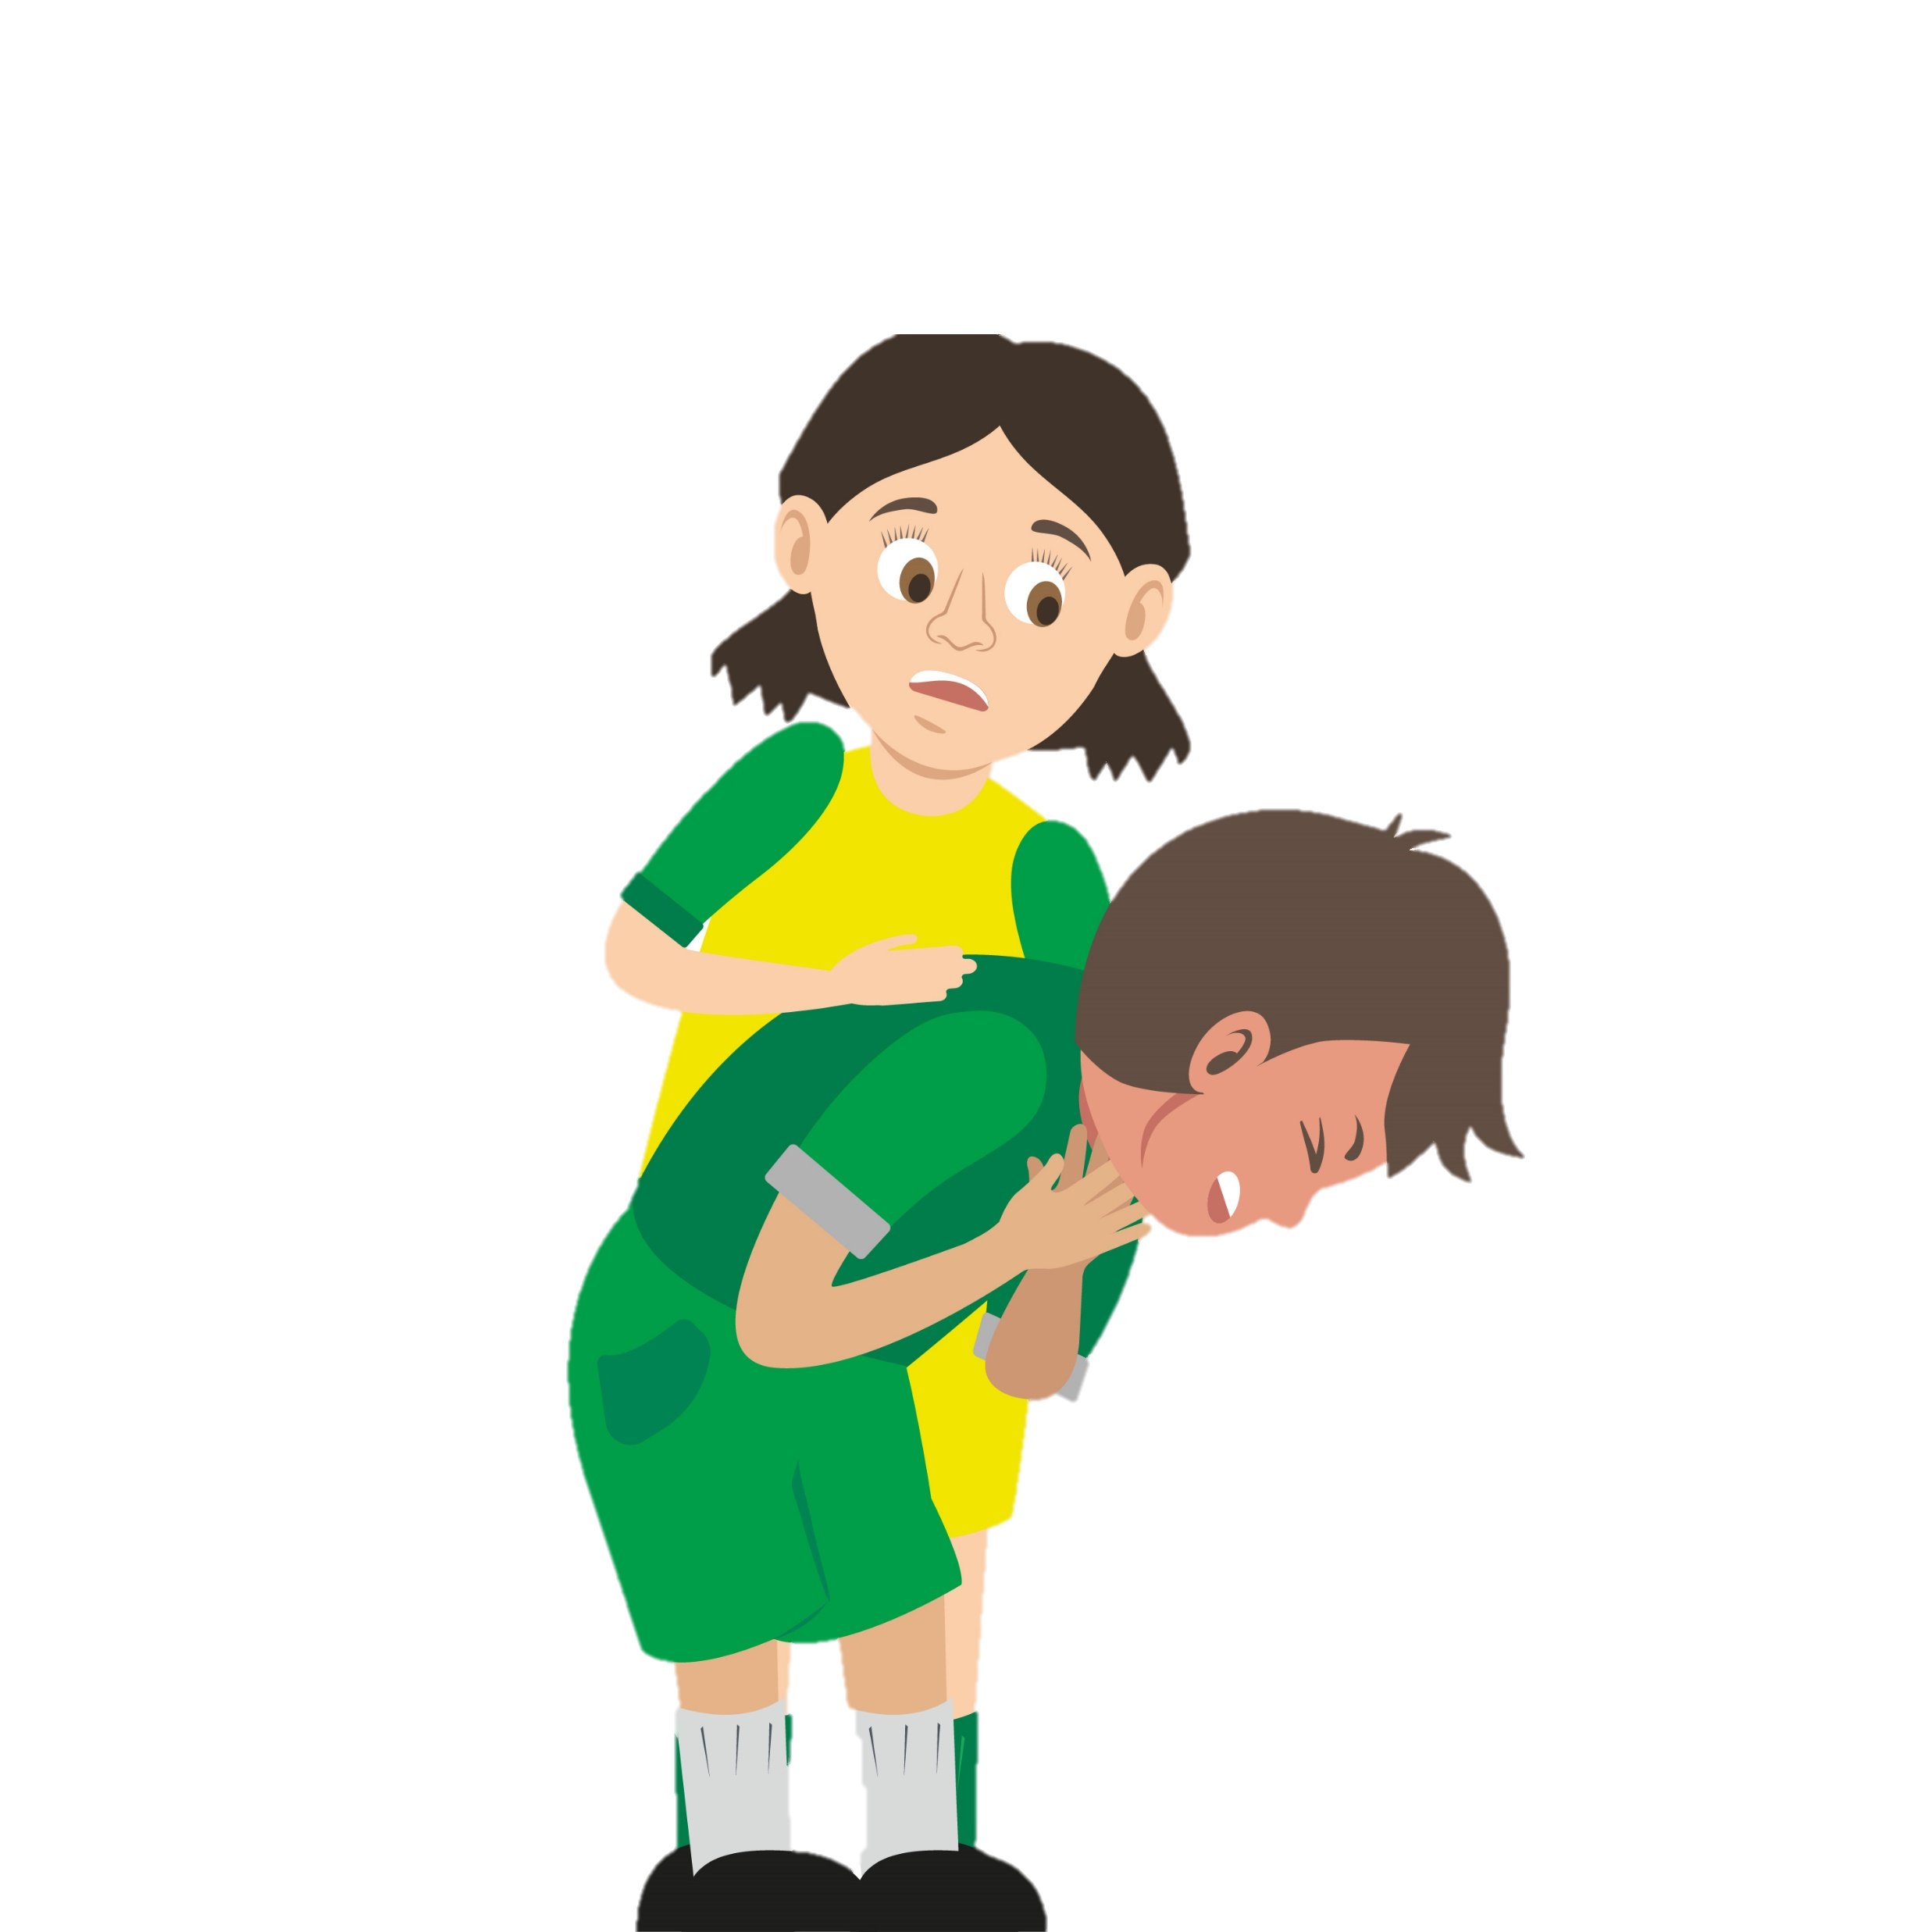







KS2 Statutory and Recommended First Aid Pathway
The Dept for Education recommends that pupils at KS2 should know:
How to make a clear and efficient call to emergency services
Concepts of basic first-aid e.g. dealing with common injuries, including head injuries.
Follow the map of health agenda recommendations on giving your pupils a sound knowledge of first aid.
“Children and young people are growing up in an increasingly complex world….they need to know how to be safe and healthy.”
(Statutory guidance, Relationships Education, Relationships and sex education (RSE)Secretary of State, July 2020)
KS2 – Year 3
Bites and stings
KS2 – Year 5 Bleeding
KS2 – Year 4
Asthma
KS2 –Year 6
Choking
This way
to KS3 First Aid
Well done…
if you have completed all modules you are a KS2 first aider
Bonus Topic
Basic Life Support
“Pupils can support their own and others’ health and wellbeing, including basic first aid.”
(Dept for Education, Physical health and wellbeing, July 2020)

